Slide 1

IT Innovation Lab
Predicting IPL Score using various Regressor Models
Project by :
Name: Raju Kumar
Branch: Information Technology
Roll No.: 2111030
Reg. No.: 21030480031
College: BIT Sindri, Dhanbad

Slide 2

Problem Statement
Get Ready available data of IPL(ball by ball) of different players. Try to build a model which can predict from earlier performances, what could be range of run scored by a team in a match

Slide 3
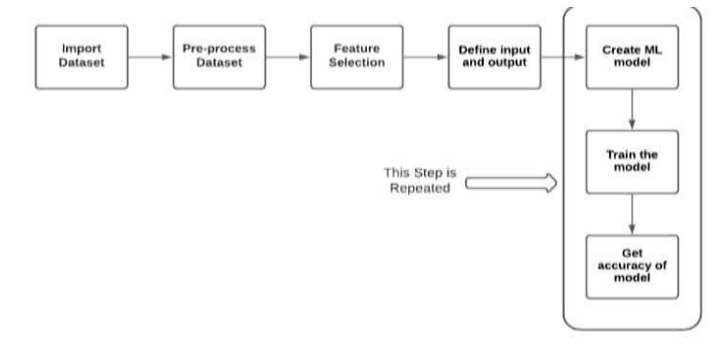
Block Diagram and Methodology

Slide 4
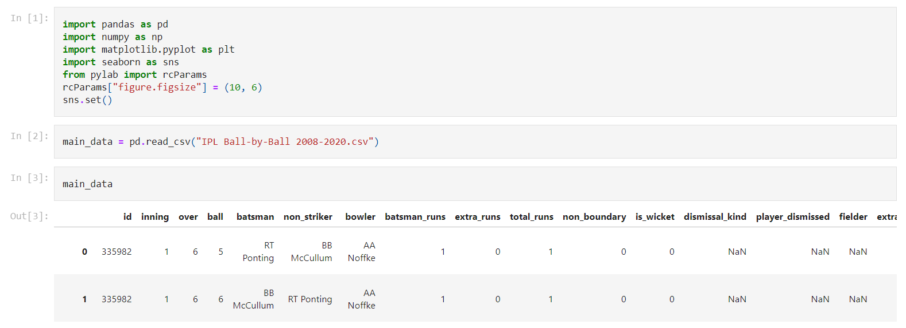
Getting the Dataset from Kaggle

Slide 5

Dropping Unnecessary Features

Slide 6






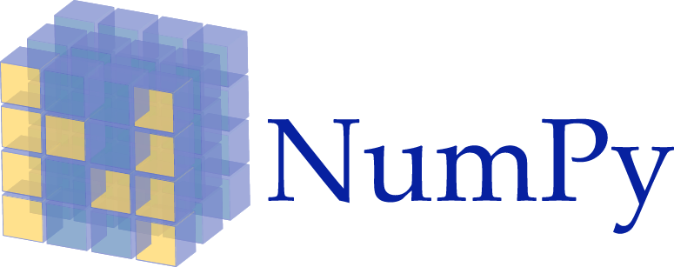


Technologies Used
Python
Html
CSS
JavaScript
Bootstrap
Flask
NumPy
Matplotlib
Scikit learn
Heroku

Slide 7

Parameters Used
Output Parameter –
Total run score by a team
Input Parameters -
Venue of a match(Stadium name)
- Batting team name
Bowling team name
Current Score board
Score board of last 5 overs.

Slide 8











Algorithms Used
Gradient
Ridge
Boost
Ada Boost
Ada
Random
Forest
Decision Tree
Linear
Ridge
Lasso

Slide 9
Overview of Algorithms
Ridge - Ridge regression is a model tuning method that is used to analyse any data that suffers from multicollinearity. This method performs L2 regularization.
Ada Boost - AdaBoost regressor is a meta-estimator that begins by ﬁtting a regressor on the original dataset and then ﬁts additional copies of the regressor on the same dataset but where the weights of instances are adjusted according to the error of the current prediction.

Slide 10
Overview of Algorithms
Random Forest - A random forest is a meta estimator that fits a number of classifying decision trees on various sub-samples of the dataset and uses averaging to improve the predictive accuracy and control over-fitting.
Lasso - Lasso regression is a type of linear regression that uses shrinkage. Shrinkage is where data values are shrunk towards a central point, like the mean.

Slide 11
Overview of Algorithms
Decision Tree - It is a tree-structured classifier, where internal nodes represent the features of a dataset, branches represent the decision rules and each leaf node represents the outcome. In order to build a tree, we use the CART algorithm, which stands for Classification and Regression Tree algorithm.
Gradient Boost - It gives a prediction model in the form of an ensemble of weak prediction models, which are typically decision trees. When a decision tree is the weak learner, the resulting algorithm is called gradient-boosted trees; it usually outperforms random forest.

Slide 12

Model Evaluation Parameters
The eﬃciency of the models used has been evaluated using the following performance metrics :
RMSE (Root Mean Square Error) - RMSE is the square root of the mean of the square of all of the error.
Mean Absolute Error- Absolute error refers to the magnitude of difference between the prediction of an observation and the true value of that observation.
R2 Score - R2 Score indicates the percentage of the variance in the dependent variable that the independent variables explain collectively.

Slide 13
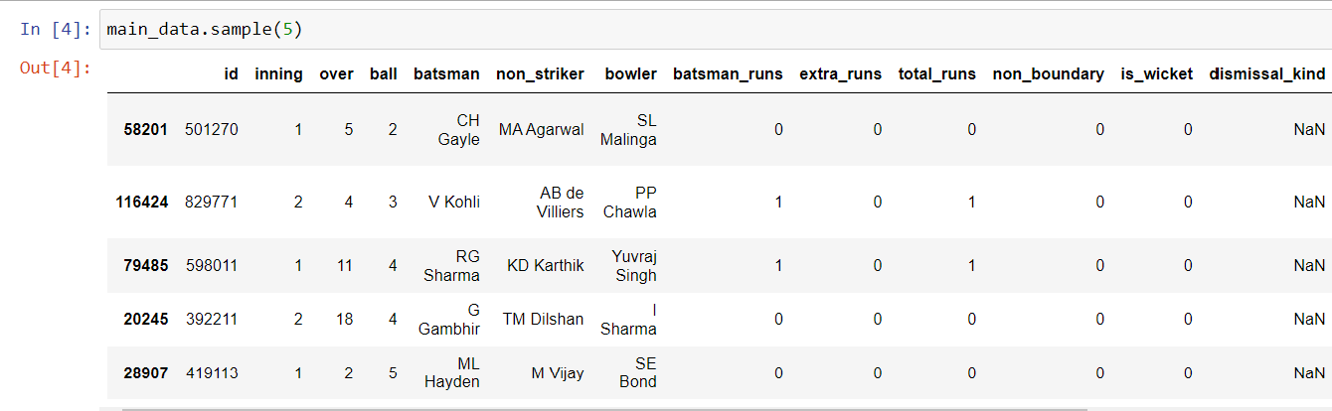
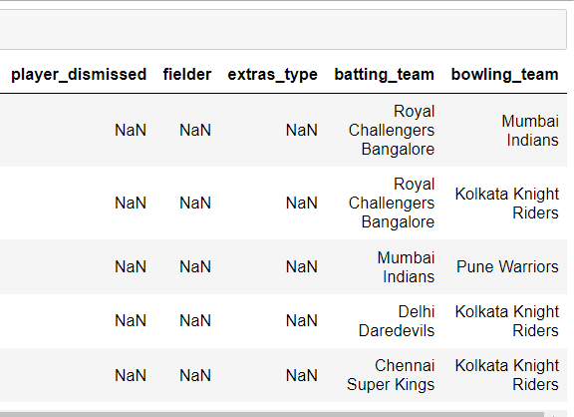

Dataset: Overview

Slide 14
Roadmap of Project
Dataset was taken from Kaggle and were visualised by using table and plots.
7 different ML algorithms were run on Model.
Comparing b/w Random Forest and Gradient Boost
1
3
5
2
4
6
The dataset was divided into 8:2 ratio randomly for training and validation.
MAE, MSV and RMSV was calculated for each algorithms and model.
Created a web app using flask and hosted it on heroku.

Slide 15
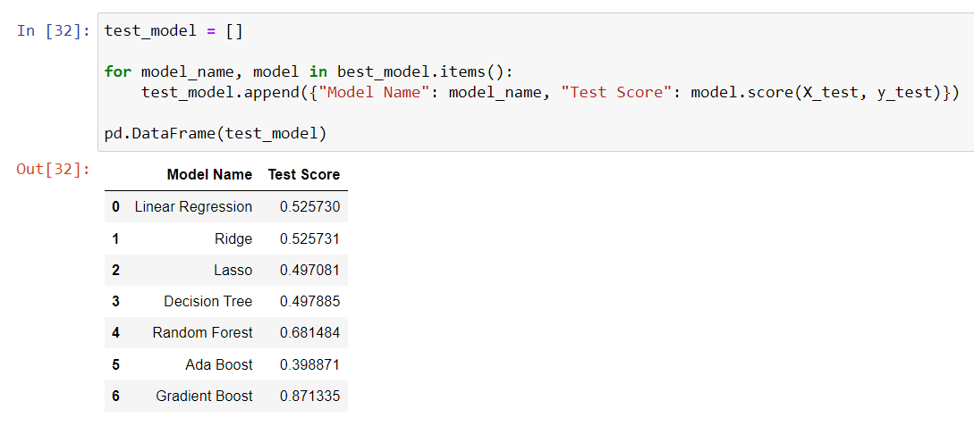

Results & Comparison

Slide 16
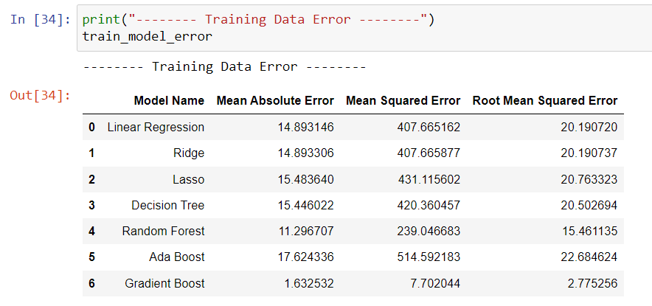
Results & Comparison

Slide 17
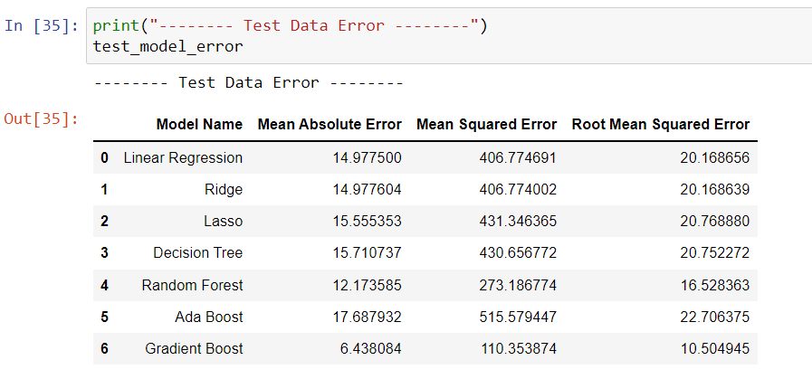
Results & Comparison

Slide 18

Model Selection
Gradient Boost algorithm gives 0.850539 r2_score & 1.632532 MAE on train dataset and 0.871335 r2_score & 6.438084 MAE on test dataset
Random Forest algorithm gives 0.672894 r2_score & 11.296707 on train dataset and 0.681484 r2_score & 12.173585 on test dataset

Slide 19
Model Selection
Difference of train dataset MAE and test dataset MAE is 4.805552 for Gradient Boost
Difference of train dataset MAE and test dataset MAE is 0.876878 for Random Forest
Here accuracy of gradient boost is higher than random forest but Random Forest's MAE difference between train and test dataset is lower than Gradient Boost
so if I select Gradient Boost algorithm which has high r2_score but still our model not perform stable as it perform on train dataset because MAE difference between train and test dataset is high that's why it might generate overfitting issue.
if I select Radom Forest algorithm which has low r2_score but it will perform stable as it performed on train dataset because MAE difference between train and test dataset is low
I'm selecting Random Forest as final model

Slide 20
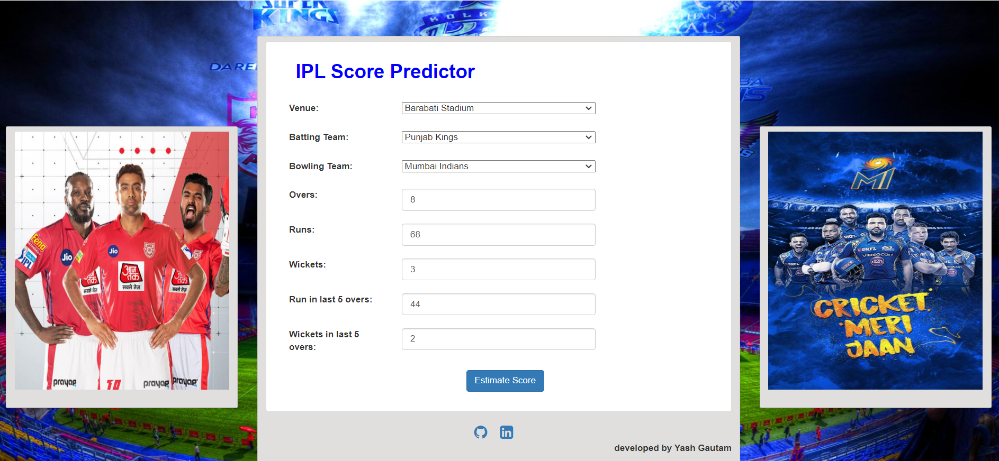
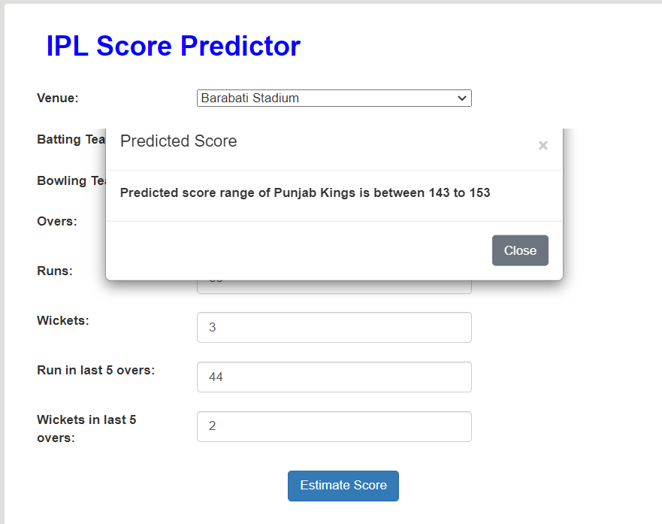

Flask Web App

Slide 21

Applications
In 2008 Indian Premier League, BCCI was established so many bettings were played on it like dream 11. So, there is huge demand for the algorithms that predicts the best result of score and winning team that is more important. Machine learning is the best way for prediction.

Slide 22

Future Work
Implementing neural network and deep learning mechanism for improving model
By using time series analysis we can include performance of a team in recent time.
Adding a new team after getting their data

Slide 23
References
Research paper on Score Predictor
Random Forest Algorithm Research Paper
Gradient Boost Algorithm Research Paper
Ada Boost Algorithm Research Paper

Slide 24




Thank You

